Slide 1
Lecture 7: Functional and OO Design Descriptions
Copyright W. Howden

Slide 2
Executable Units
Functional
  Procedures
  Functions
  Subroutines
Modules
  Collections of procedures
  Interface procedures
Object Oriented
  Classes
  Interfaces
  Class methods
Components
  Collections of classes
  Interface classes
Copyright W. Howden

Slide 3
Functional Design
Module connection/relationship models
Design development
  Top down design
  Program refinement
Module/Procedure call/use diagrams
Algorithm design descriptions
  Pseudo-Code
  Nassi-Schneiderman diagrams
  Decision Tables
Copyright W. Howden

Slide 4
Object Oriented Design
Component connection/relationship models
Design development
  interaction sequence, collaboration diagrams
  visibility analysis
Design Diagrams – Class Structure
Method design descriptions
  algorithm design descriptions
Copyright W. Howden

Slide 5
Functional Design Diagrams – Function Interactions
Tree structure
Nodes are procedures or modules
Arcs are calls or uses
Arc notation: shows flow of data from one node to another: data couples
Computational and control flow couples
Copyright W. Howden

Slide 6
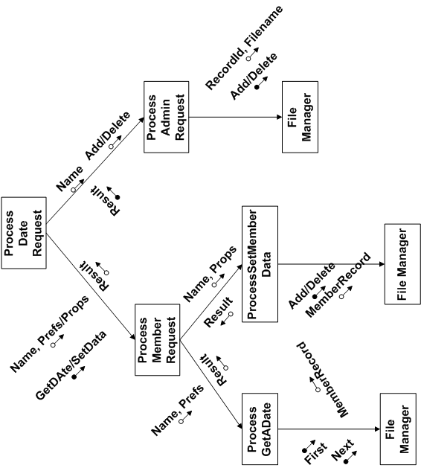

Slide 7
DS Top Down Design
  DS process
    Dater or Admin process
    Dater process
      GetADate or SetMember Data process
        Filemanager process
    Admin process
      Add or Delete process
        FileManager process
Copyright W. Howden

Slide 8
DS PseudoCode and Program Refinement
Member Data getADate(DaterPreferences daterPrefs)
{ Record record; Boolean match = false;
  record = filemanager(“getFirst”);
  see if record matches daterPrefs and set match
  while ((record =/ null) and (match == false))
  { record = filemanager(“getNext);
  see if record matches daterPrefs and set match
  }
  if (match = = false) return null else return record;
  }

Slide 9
Data Visibility
For Functional Programs
Data item: a function f uses or accesses a data item. How do we enable it to access and manipulate this data.
  Local variable: declare one and assign data to it
  Parameter: accessed passed data using formal parameter, or assign it to a local variable
  Assign and reference data via a global variable

Slide 10
Type Visibility of
Functional Programs
Variable declarations involve a type
Type definition visibility
  Global generic types
  Global struct definitions (C )
  Local struct definitions
  Includes files

Slide 11
Object Oriented Design Diagrams – Class Models
Graph structure
Nodes correspond to classes
Arcs are relationships between classes
Visibility analysis in class diagrams
  Solid arc from A to B indicates A has a class variable whose values are instances of B
  Dotted arcs indicate other kinds of visibility implementations

Slide 12
Diagram Details
Nodes/Classes
  Attributes: associated simple variables
  Names and signatures of methods
  Similar to Domain model classes, + methods
Arcs
  type of relationship, roles, multiplicity
Separate details: for readability

Slide 13
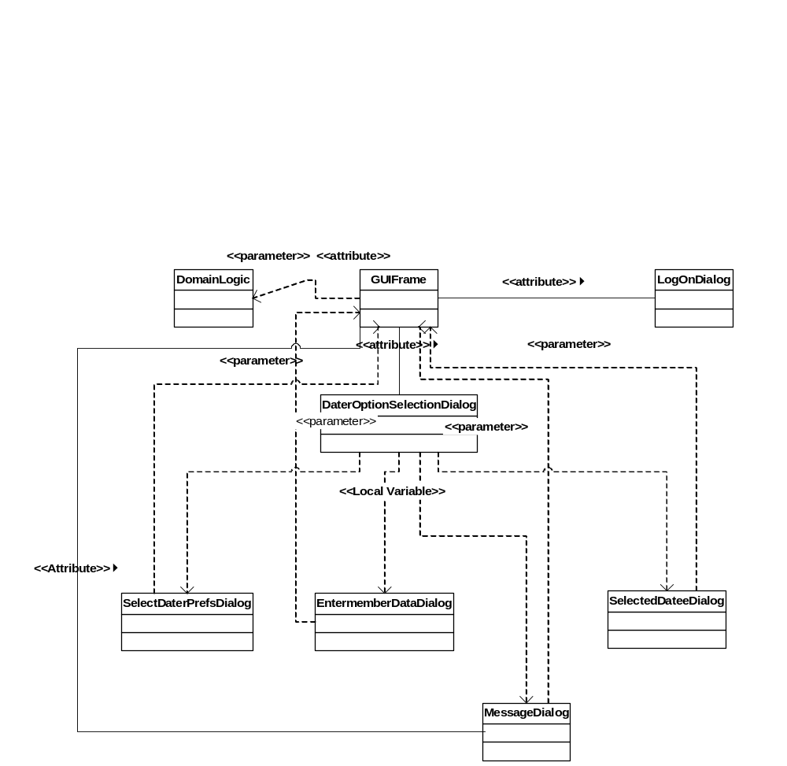

Slide 14
Object Visibility for Object Oriented Designs
An object X of class A has the ability to see or reference an object Y of class B
E.g. in a collaboration diagram, X sends a message to Y
Will require some way of achieving this visibility in the design
Design Class Diagram can be used to document visibility implementation decisions

Slide 15
Ways to Achieve Object Visibility
Attribute
Parameter
Local Variable
Global

Slide 16
Attribute Visibility
Class A can be defined with an attribute variable y whose values are of class B, which can be assigned the value Y
E.g. :GUIFrame object in DS sends a getUserType() message to object dL:DomainLogic

Slide 17
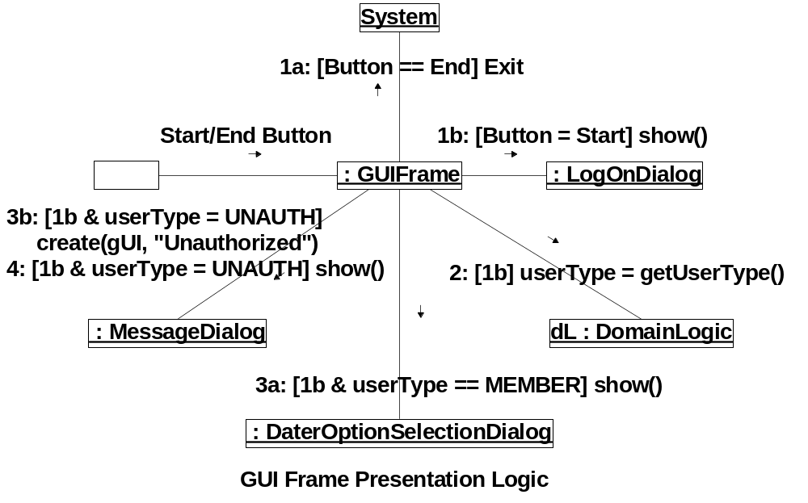
Copyright W. Howden

Slide 18
Attribute Visibility Solution
Class GUIFrame, the class for the object :GUIFrame, will have an attribute/class variable dL of type DomainLogic whose value is the object dL.
Permanent association needed. Attribute visibility is a good solution.

Slide 19
Parameter Visibility
Y is referenced inside a method m() for X’s class A. Y can be passed as a parameter y of m() which can be referenced in m()
Eg. GUIFrame is going to set dL attribute variable to the dL Object, i.e. establish the attribute visibility in the earlier example.

Slide 21
Parameter Visibility Solution
Parameter dL:DomainLogic will be passed as a parameter in the constructor for GUIFrame.
Temporary parameter visibility is then changed to a more permanent attribute visibility

Slide 22
Local Variable Visibility
A method m() in the class A for X can be defined with a local variable y of class B, that can be assigned to Y.
E.g. In the GUI example, when a user selects the option of getting a date, the system will create and display an SelectDataPrefsDialog.

Slide 23
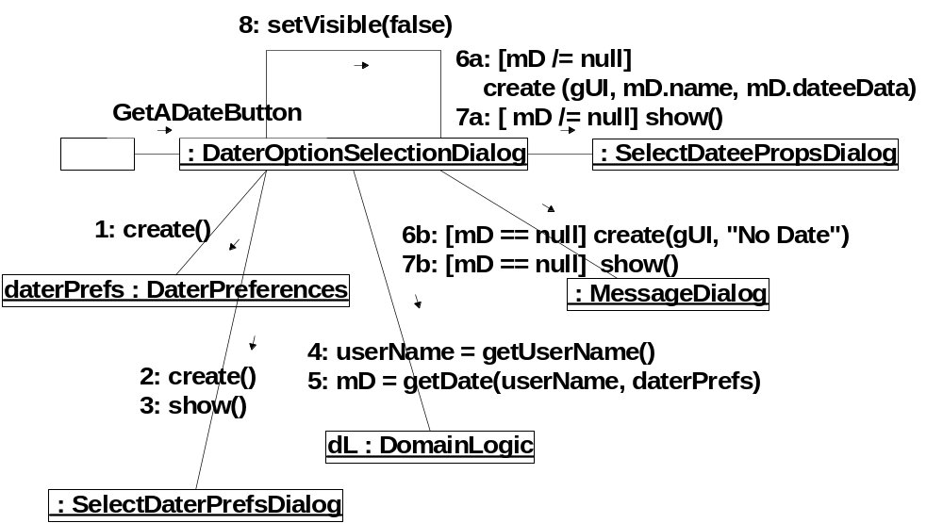

Slide 24
Local Variable
Visibility Solution
Solution: the method in DaterOptionsSelectionDialog that is invoked when the getDate() button is pressed will have a local variable of type SelectDaterPrefsDialog that can be assigned to the object :SelectDaterPrefsDialog that is created at this point.

Slide 25
Global Visibility
The object Y is made global to all classes so that all can reference it.
E.g. The Message Dialog is used over and over in DS.
Global visibility solution. Create a top level class that is global to all that use it. Assume it has a static object x whose value is dialog instance that can be re-used with different messages

Slide 26
GUI Example
Simple diagram with relationships
Sample detailed class descriptions given separately
  Each has setVisible(), show(), a constructor
  and a method for responding to a button event that will be called by the OS
Copyright W. Howden

Slide 27
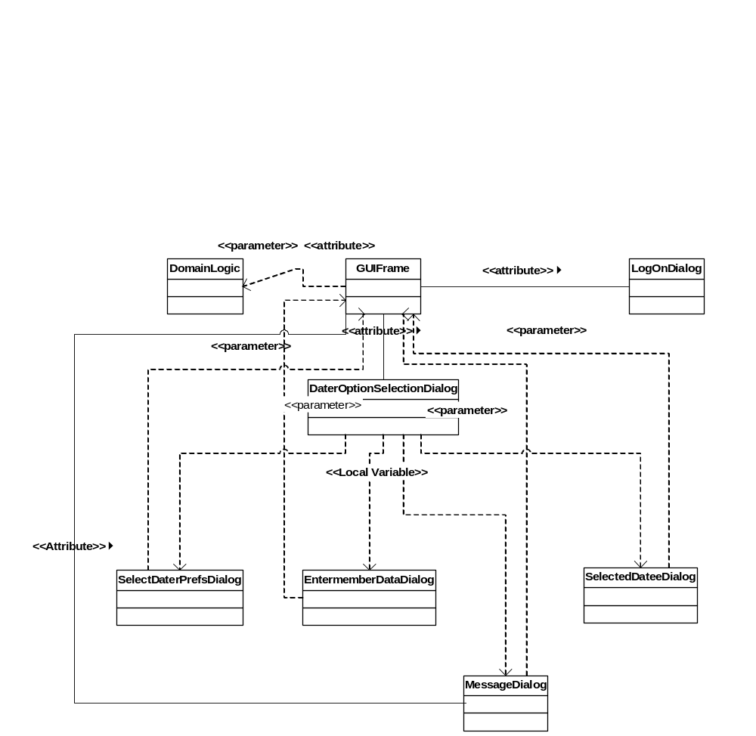

Slide 28
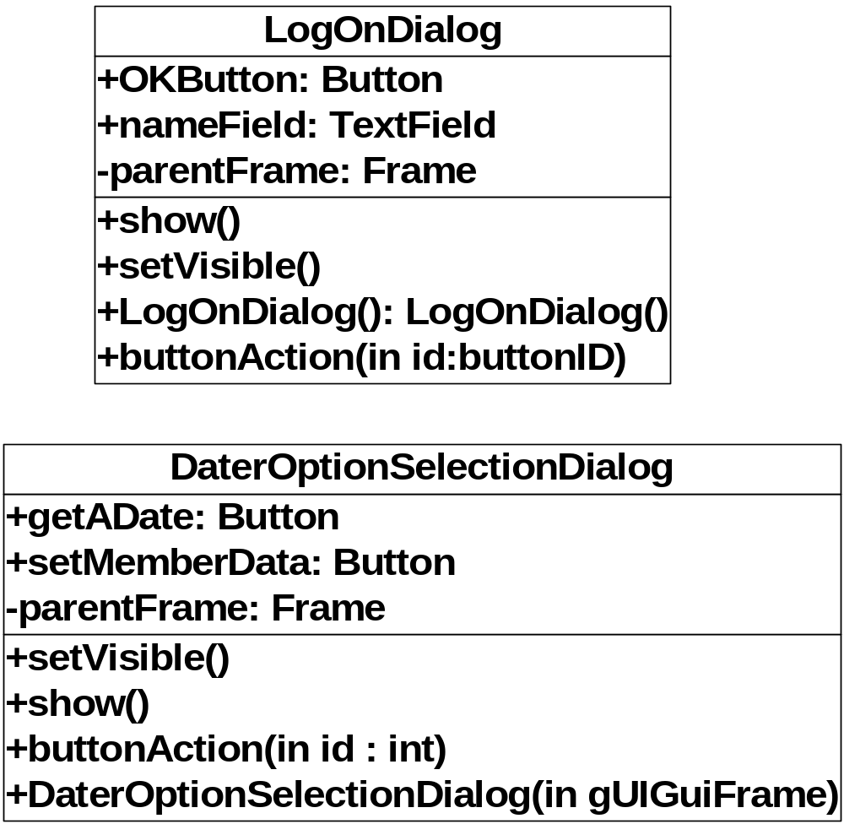

Slide 29
O/O Programming and Class Visibility
Declaration of an object of some class
  E.g. Attribute/class variable, local variable (method), parameter (method), global
  How is the class definition known in that context?
  Determines structuring of class definitions
Java: Inner class definition, file visibility, package visibility, import visibility
Copyright W. Howden

Slide 30
Class Visibility – Inner Classes
Class A has an attribute variable y of class B
Include the definition for class B inside class A
E.g. in DS, all of the GUI class definitions are inner classes in GUI, which makes it possible to define instances of them
Copyright W. Howden

Slide 31
File Visibility
A class in a file can access other class definitions in that file
E.g. DS The class definition for the message class file is included in the GUI class file. GUI is the public object in this file (Java)

Slide 32
Package Visibility
The classes in one file in a package can see the public and non-private classes in other files. Private classes in a file are not visible outside the file.

Slide 33
Import Visibility
One file can declare itself to be part of a named package
A file can import files in specified packages
E.g. In DS GUI has parameter visibility to a Domain Logic object that is passed to its constructor. GUI has visibility to the DomainLogic class via an import statement

Slide 34
Domain Logic Examples
Object visibility problem
  An object X of class A has the ability to see or reference an object Y of class B
  E.g. in a collaboration diagram, X sends a message to Y
  Will require some way of achieving this visibility in the design

Slide 35
Object Visibility Solutions
Attribute
Parameter
Local Variable
Global

Slide 36
Attribute Visibility
Class A can be defined with an attribute variable y whose values are of class B, which can be assigned the value Y
E.g. dL:DomainLogic object in DS sends a getMemberData() message to object :DataBase

Slide 37
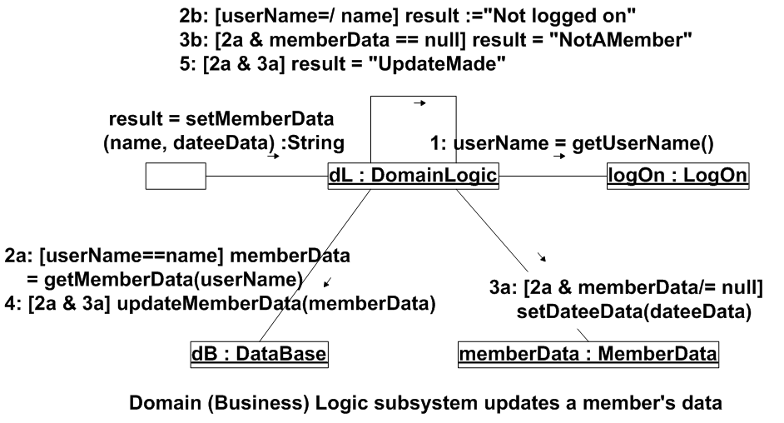
Copyright W. Howden

Slide 38
Attribute Visibility Solution
Class DomainLogic, the class for the object dL:DomainLogic, will have an attribute/class variable dB of type DataBase whose value is the object dB.
Permanent association needed. Attribute visibility is a good solution.
Copyright W. Howden

Slide 39
Parameter Visibility
Y is referenced inside a method m() for X’s class A. Y can be passed as a parameter y of M() which can be referenced in m()
E.g. In the DS, DomainLogic is going to set dB attribute variable to the dB Object, i.e. establish the attribute visibility in the earlier example
Copyright W. Howden

Slide 40
Copyright W. Howden

Slide 41
Parameter Visibility Solution
Parameter dB:DataBase will be passed as a parameter in the constructor for DomainLogic.
Temporary parameter visibility is then changed to a more permanent attribute visibility
Copyright W. Howden

Slide 42
Local Variable Visibility
A method m() in the class A for X can be defined with a local variable y of class B, that can be assigned to Y.
E.g. DS class DomainLogic has a method setMemberData that is called from GUI. It calls getMemberData(userName) in the data base to get back a member record which it then processes.
Copyright W. Howden

Slide 43
Copyright W. Howden

Slide 44
Local Variable
Visibility Solution
Solution: the setMemberData(), method will have a local variable mD which it can assign to the MemberData record returned from getMemberData(). This will enable it to maintain temporary visibility during the life of setMemberData.
Copyright W. Howden

Slide 45
Domain Logic Class Diagram
Shows association relationships (attributes and other kinds of dependencies)
Derived from above and other Collaboration Models
Class details (attributes and methods) omitted
Associations show class visibility also
Copyright W. Howden

Slide 46
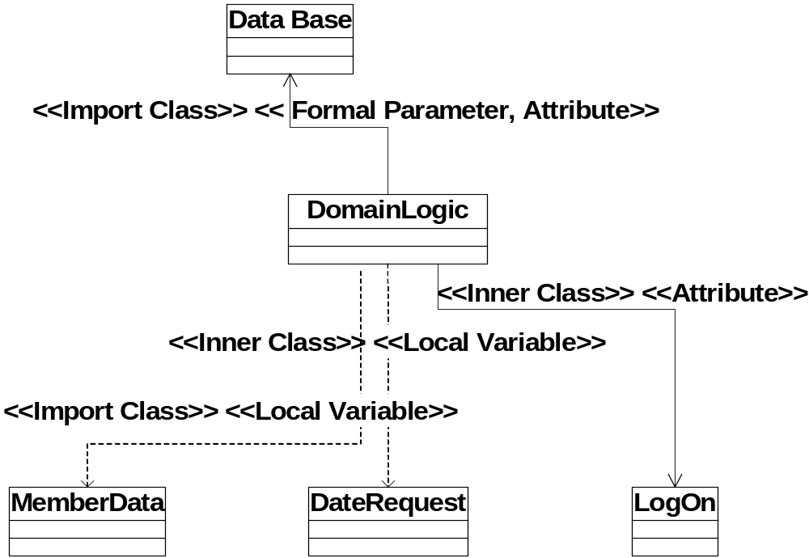
Copyright W. Howden

